Slide 1
GPRS/UMTS Security Requirements
Guto Motta
guto@la.checkpoint.com
SE Manager Latin America

Slide 2
Agenda
GSM / GPRS Network Architecture
Security Aspects of GPRS
Attacks and Impact
GTP Awareness

Slide 3
GSM / GPRS Network Architecture

Slide 4
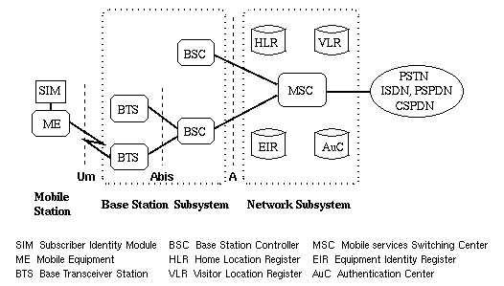
GSM Architecture

Slide 5
General Packet Radio Service
Support for bursty traffic
Efficient use of network and radio resources
Provide flexible services at relatively low costs
Possibility for connectivity to the Internet
Fast access time
Happily co-existence with GSM voice
  Reduce Investment

Slide 6
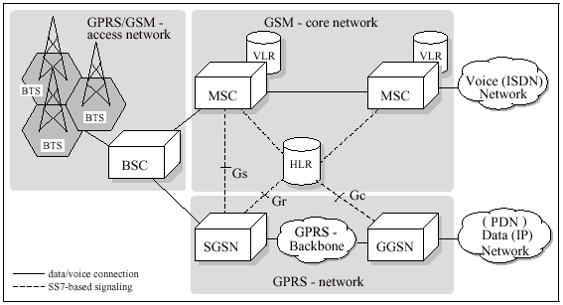
GPRS Network Architecture
New

Slide 7
GPRS Additions to GSM
New components introduced for GPRS services:
  SGSN (Serving GPRS Support Node)
  GGSN (Gateway GPRS Support Node)
  IP-based backbone network
Old components in GSM upgraded for GPRS services:
  HLR
  MSC/VLR
  Mobile Station

Slide 8
SGSN - Serving GPRS Support Node
At the same hierarchical level as the MSC.
Transfers data packets between Mobile Stations and GGSNs.
Keeps track of the individual MSs’ location and performs security functions and access control.
Detects and registers new GPRS mobile stations located in its service area.
Participates into routing, as well as mobility management functions.

Slide 9
GGSN - Gateway GPRS Support Node
Provides inter-working between Public Land Mobile Network (PLMN) and external packet-switched networks.
Converts the GPRS packets from SGSN into the appropriate packet data protocol format (e.g., IP or X.25) and sends out on the corresponding packet data network.
Participates into the mobility management.
Maintains the location information of the mobile stations that are using the data protocols provided by that GGSN.
Collects charging information for billing purpose.

Slide 10
GPRS Interfaces
Gb
Other GPRS
PLMN
Gn
Gi
GGSN
Gp
Gf
EIR
Gd
SMS

Slide 11



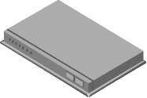
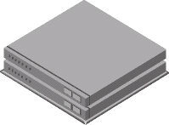


GPRS Topology
Roaming Partner
GGSN
SGSN
BSS
GRX
BSS/UTRAN
Gp
BSS/UTRAN
SGSN
SGSN
Gn
C&B
Home PLMN
Gi
GGSN
Internet

Slide 12
Packet Data Protocol (PDP)
Packet Data Protocol (PDP)
  Address
  Context
  Logical tunnel between MS and GGSN
  Anchored GGSN for session
PDP activities
  Activation
  Modification
  Deactivation

Slide 13
PDP Context
When MS wants to send data, it needs to activate a PDP Address
This activation creates an association between the subscriber’s SGSN and GGSN
The information record maintained by the SGSN and GGSN about this association is the PDP Context

Slide 14
PDP Context Procedures
MS initiated
MS
BSS
SGSN
GGSN
Activate PDP Context Request
[PDP Type, PDP Address,
QoS, Access Point...]
Security Functions
Create PDP Context
Request
[PDP Type, PDP Address,
QoS, Access Point...]
Create PDP Context
Response
[PDP Type, PDP Address,
QoS, Access Point...]
Activate PDP Context Accept
[PDP Type, PDP Address,
QoS, Access Point...]

Slide 15
GPRS Backbone
All packets are encapsulated using GPRS Tunneling Protocol (GTP)
The GTP protocol is implemented only by SGSNs and GGSNs
GPRS MSs are connected to a SGSN without being aware of GTP
An SGSN may provide service to many GGSNs
A single GGSN may associate with many SGSNs to deliver traffic to a large number of geographically diverse mobile stations

Slide 16
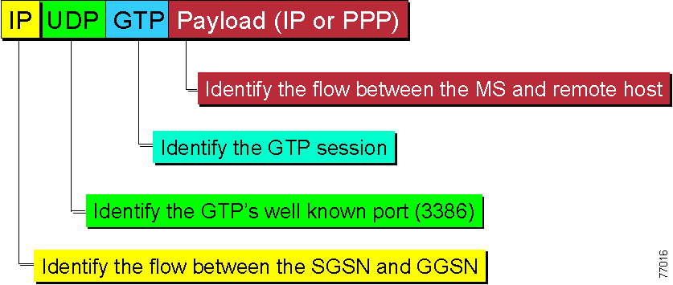
GTP Packet Structure

Slide 17
GPRS Topology
Roaming Partner
GGSN
SGSN
BSS
GRX
Gp
BSS/UTRAN
BSS/UTRAN
SGSN
SGSN
Gn
C&B
Home PLMN
Gi
GGSN
Internet

Slide 18
Security Aspects of GPRS

Slide 19
GTP Security
GTP – GPRS Tunneling Protocol
  Key protocol for delivering mobile data services
GTP itself is not designed to be secure:
  “No security is provided in GTP to protect the communications between different GPRS networks.”
Regular IP firewalls:
  Cannot verify encapsulated GTP packets
  Can only filter certain known ports

Slide 20
GPRS Security
Basic Problem:
  SGSN handles authentication
  GGSN trusts SGSN
Mobility:
  Handover of active tunnels
Fragile, “non-hardened” software
Roaming expands your “circle of trust”
GRX: Trusting external provider
IP lesson learned: Control your own security

Slide 21
GPRS Security
A distinction needs to be done
  Security of Radio Channel
  Security of IP and Core supporting network
In GPRS encryption stops at the SGSN
After SGSN traffic is all TCP/IP
All typical TCP/IP attacks vectors apply

Slide 22
What is the real risk?
Risk vectors
  Own mobile data subscribers
  Partner networks – GRX
Lessons learned from the IP world
  New security vulnerabilities constantly being found in software using Internet Protocol (IP)
  Evolving GPRS/UMTS software will be no different
  You cannot depend on the network to provide your security - you need to provide your own

Slide 23
Attacks and Impact

Slide 24
Possible Attacks
Over-Billing Attacks
  Charging the customers for traffic they did not use
Protocol Anomaly Attacks
  Malformed or corrupt packets
Infrastructure Attacks
  Attempts to connect to restricted machines such as the GGSN

Slide 25
Possible Attacks
GTP handover
  Handover between SGSNs should not allow handover to an SGSN that belongs to a PLMN with no roaming agreement.
Resource Starvation Attacks
  DoS attacks

Slide 26






Over-Billing Attack
IMSI V
Stateful table
charging
gateway
src
dst
victim
terminal
radio access
network
GPRS
backbone
internet access
network
internet
SGSN
GGSN
internet
firewall
malicious
server
IMSI/IP table
IP 19.8.7.6
malicious
terminal
IMSI M
initially, all tables are empty
malicious and victim terminals have no PDP context activated
Source: Gauthier, Dubas & Vallet

Slide 27
Over-Billing Attack
IMSI V
Stateful table
charging
gateway
src
dst
victim
terminal
radio access
network
GPRS
backbone
internet access
network
internet
SGSN
GGSN
internet
firewall
malicious
server
IMSI/IP table
IP 19.8.7.6
M
10.3.2.1
malicious
terminal
GTP:Create PDP Context Request
GTP:Create PDP Context Response (IP addr = 10.3.2.1)
IMSI M
malicious GPRS terminal activates GPRS
malicious GPRS terminal is assigned IP address 10.3.2.1
IP 10.3.2.1
SM:Activate PDP Context Request
SM:Activate PDP Context Accept
Source: Gauthier, Dubas & Vallet

Slide 28
Over-Billing Attack
IMSI V
Stateful table
charging
gateway
src
dst
victim
terminal
10.3.2.1
19.8.7.6
19.8.7.6
10.3.2.1
radio access
network
GPRS
backbone
internet access
network
internet
SGSN
GGSN
internet
firewall
malicious
server
TCP:SYN
IMSI/IP table
IP 19.8.7.6
TCP:SYN/ACK
TCP:ACK
M
10.3.2.1
malicious
terminal
IMSI M
malicious party opens a TCP connection between terminal and server
IP 10.3.2.1
Source: Gauthier, Dubas & Vallet

Slide 29
Over-Billing Attack
IMSI V
Stateful table
charging
gateway
src
dst
victim
terminal
10.3.2.1
19.8.7.6
19.8.7.6
10.3.2.1
radio access
network
GPRS
backbone
internet access
network
internet
SGSN
GGSN
internet
firewall
malicious
server
IMSI/IP table
IP 19.8.7.6
TCP:FIN
M
10.3.2.1
malicious
terminal
GTP:Delete PDP Context Request
IMSI M
malicious server starts sending TCP FIN packets
malicious GPRS terminal deactivates its PDP context
IP 10.3.2.1
SM:Deactivate PDP Context Request
Source: Gauthier, Dubas & Vallet

Slide 30
Over-Billing Attack
IMSI V
Stateful table
charging
gateway
src
dst
victim
terminal
10.3.2.1
19.8.7.6
19.8.7.6
10.3.2.1
radio access
network
GPRS
backbone
internet access
network
internet
SGSN
GGSN
internet
firewall
malicious
server
IMSI/IP table
IP 19.8.7.6
TCP:FIN
malicious
terminal
GTP: Delete PDP Context Response
IMSI M
GGSN drops the FIN packets
malicious terminal still GPRS attached
SM: Deactivate PDP Context Accept
Source: Gauthier, Dubas & Vallet

Slide 31
Over-Billing Attack
IMSI V
Stateful table
charging
gateway
src
dst
victim
terminal
10.3.2.1
19.8.7.6
19.8.7.6
10.3.2.1
radio access
network
GPRS
backbone
internet access
network
internet
SGSN
GGSN
internet
firewall
malicious
server
IMSI/IP table
IP 19.8.7.6
TCP:FIN
V
10.3.2.1
malicious
terminal
IMSI M
victim activates its PDP context
GGSM assigns IP address 10.3.2.1 to the victim terminal
Source: Gauthier, Dubas & Vallet

Slide 32
Over-Billing Attack.
IMSI V
Stateful table
IP 10.3.2.1
charging
gateway
src
dst
victim
terminal
10.3.2.1
19.8.7.6
19.8.7.6
10.3.2.1
radio access
network
GPRS
backbone
internet access
network
internet
SGSN
GGSN
internet
firewall
malicious
server
IMSI/IP table
IP 19.8.7.6
TCP:FIN
V
10.3.2.1
malicious
terminal
IMSI M
GGSN starts routing again the TCP FIN packets
victim terminal starts receiving the TCP FIN packets
Source: Gauthier, Dubas & Vallet

Slide 33
Handover – Updating PDP Contexts
Other PLMN
GGSN
Roaming
SGSN
SGSN context response
BSS
GRX
BSS/UTRAN
Gp
BSS/UTRAN
SGSN
SGSN context request
SGSN
C&B
Gn
Home PLMN
Gi
GGSN
VPN-1/FireWall-1
Update PDP context
Internet

Slide 34
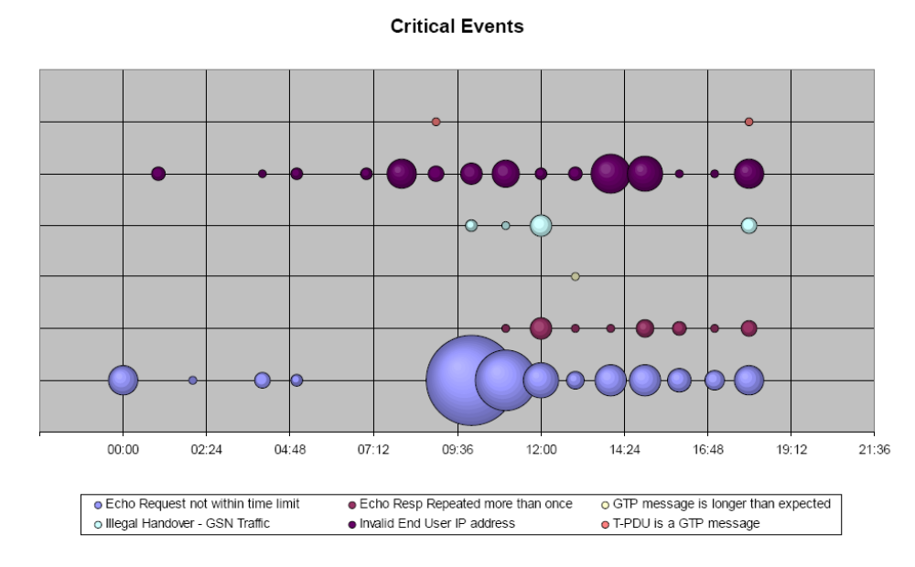
GRX Security Report
Observation Window: 19 hours

Slide 35
GTP Awareness

Slide 36
GTP Aware Security Solution
Designed for wireless operators
Dedicated to protect GPRS and UMTS networks
GTP-level security solution
Blocks illegitimate traffic “at the door”
Stateful Inspection technology
Granular security policies
Strong and Comprehensive Management Infrastructure

Slide 37
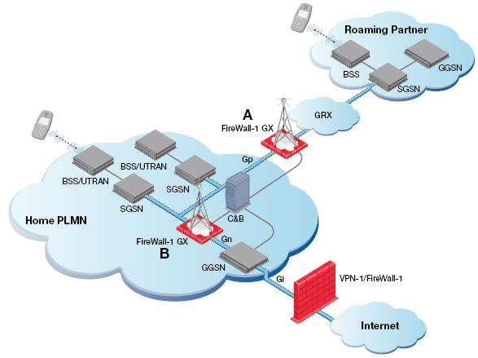
Deployment Scenarios

Slide 38
Summary
GTP itself is not designed to be secure
Basic architectural vulnerabilities
  Overbilling attack
  Infrastructure attacks
Vendor specific vulnerabilities
  Protocol anomalies
  Resource starvation
Real world, critical security events identified in GRX
Adoption of 3G services requires advanced GTP aware security solutions

Slide 39
Thank you!
Guto Motta
guto@la.checkpoint.com
SE Manager Latin America

